Slide 1
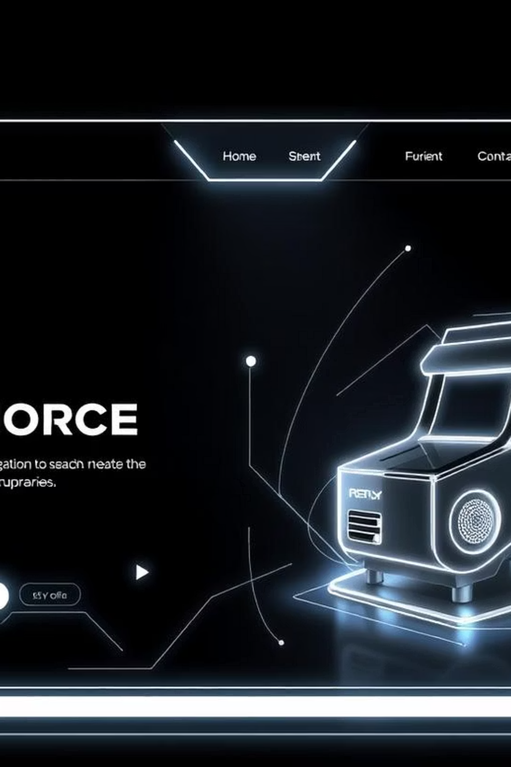
Building a Robust E-commerce Backend
This presentation outlines the development of a comprehensive backend system for an e-commerce platform, detailing its core functionalities, the technologies employed, and its key advantages. Our objective is to deliver a fully functional API that ensures seamless operations for user authentication, product management, and order processing, laying a solid foundation for a scalable and reliable online retail experience.

Slide 2
The Challenge: Crafting a Scalable E-commerce Foundation
Handling High Traffic & Scalability
Ensuring Data Security & Integrity
Managing Complex Business Logic
Developing an e-commerce backend capable of managing fluctuating traffic volumes, especially during peak sales periods, is critical. The system must scale efficiently to accommodate a growing user base and product catalog without performance degradation. This requires careful consideration of architecture, database design, and caching strategies to ensure responsiveness under load.
Protecting sensitive user data, payment information, and transaction details is paramount. The backend must implement robust security measures, including encryption, secure authentication protocols, and regular vulnerability assessments, to safeguard against breaches and maintain customer trust. Data integrity is also crucial for accurate inventory and order tracking.
E-commerce platforms involve intricate business rules, from product variations and pricing to shipping calculations and discount applications. The backend must abstract this complexity into a clean, maintainable API, allowing for easy integration with frontend applications and third-party services while supporting diverse business requirements.
Our primary challenge was to create a backend system that not only supports the fundamental operations of an e-commerce platform but also addresses the complexities of scalability, security, and intricate business logic. This involved designing a modular, API-driven architecture that is both robust and flexible enough to adapt to future demands.

Slide 3
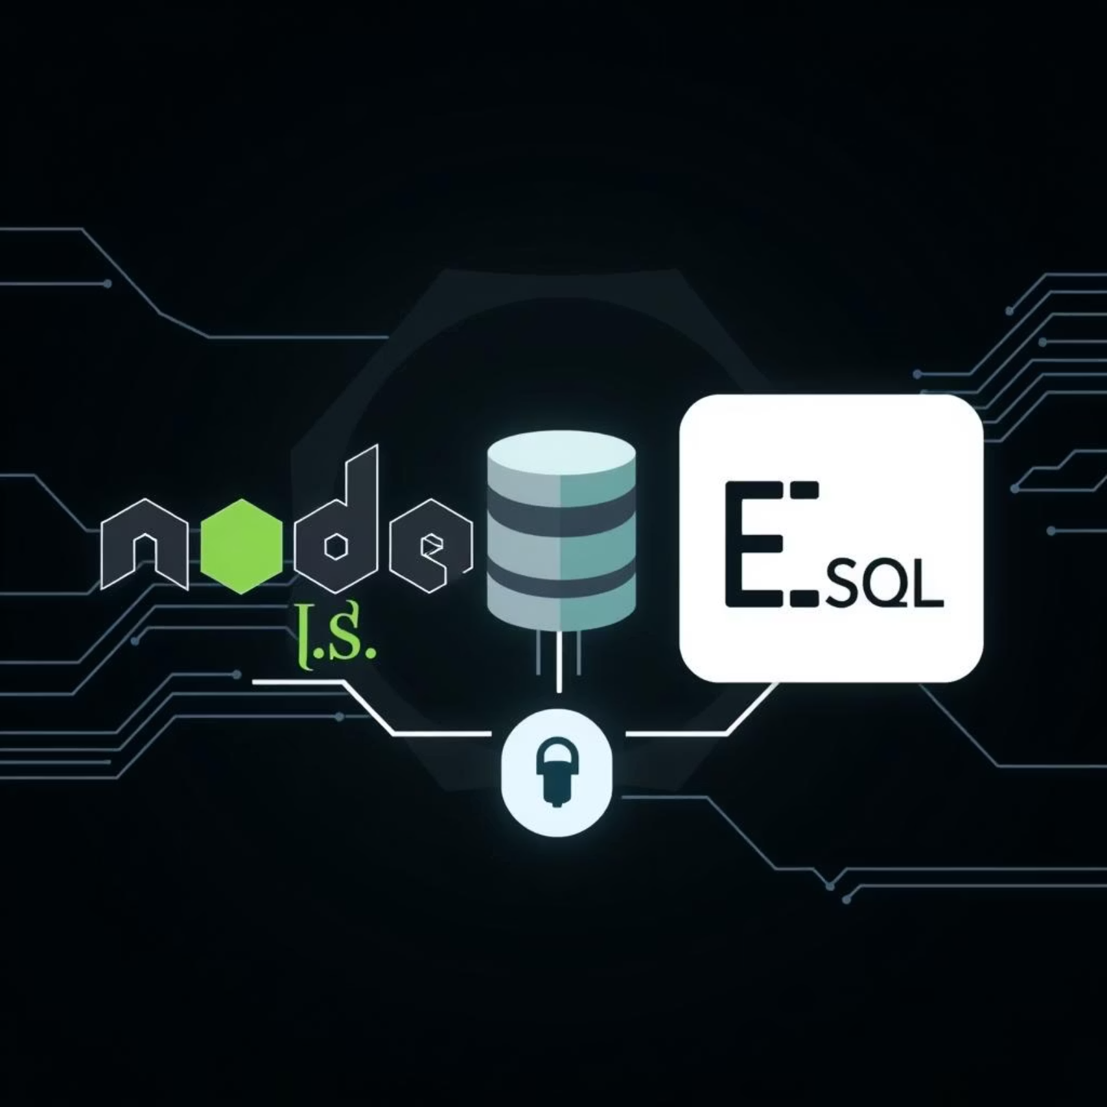
Core Technologies Driving Our Solution
Our backend solution leverages a stack of modern and powerful technologies, carefully selected for their performance, scalability, and developer-friendliness. This combination ensures a robust and efficient system capable of handling the demands of a dynamic e-commerce environment.
Framework: We utilized Node.js with Express.js for building the RESTful API. Node.js's asynchronous, event-driven nature makes it ideal for handling many concurrent connections, crucial for an e-commerce platform. Express.js provides a minimalistic and flexible framework, accelerating development and maintaining a clean code structure.
Database: PostgreSQL was chosen as our relational database. Its robustness, ACID compliance, and advanced features like JSONB support make it excellent for managing complex e-commerce data, including user profiles, product catalogs, and intricate order details, with high reliability and performance.
Authentication: JSON Web Tokens (JWT) are implemented for secure and stateless user authentication. JWTs provide a compact, URL-safe means of representing claims to be transferred between two parties, ensuring that user sessions are managed securely and efficiently without server-side storage overhead.
Security Middleware: We integrated various security middlewares, including CORS, Helmet, and express-rate-limit, to protect the API from common web vulnerabilities such as cross-origin attacks, XSS, and brute-force attempts. These measures harden the application's security posture and ensure data integrity.

Slide 4




The "Wow" Factor: Unparalleled Performance and User Experience
Blazing Fast API Response Times
Fortified Security Architecture
Leveraging Node.js's non-blocking I/O and efficient asynchronous processing, our API delivers exceptionally fast response times. This translates into a highly responsive user experience, reducing load times and enhancing customer satisfaction, especially during high-traffic periods.
With JWTs, bcrypt for password hashing, and comprehensive middleware, our backend is built with security as a top priority. This ensures robust protection of sensitive user data and transactions, instilling confidence in both customers and stakeholders.
Modular and Maintainable Codebase
Scalability for Future Growth
Our API follows a clean, modular architecture, making it highly maintainable and easily extensible. This allows for rapid development of new features and smooth integration with future services, significantly reducing technical debt and development costs.
Designed with scalability in mind, the backend can effortlessly handle increasing loads and data volumes. This ensures that the platform can grow without significant architectural changes, supporting long-term business expansion and market reach.
These differentiating factors collectively provide a superior foundation for any e-commerce venture, positioning it for long-term success and customer loyalty.

Slide 5

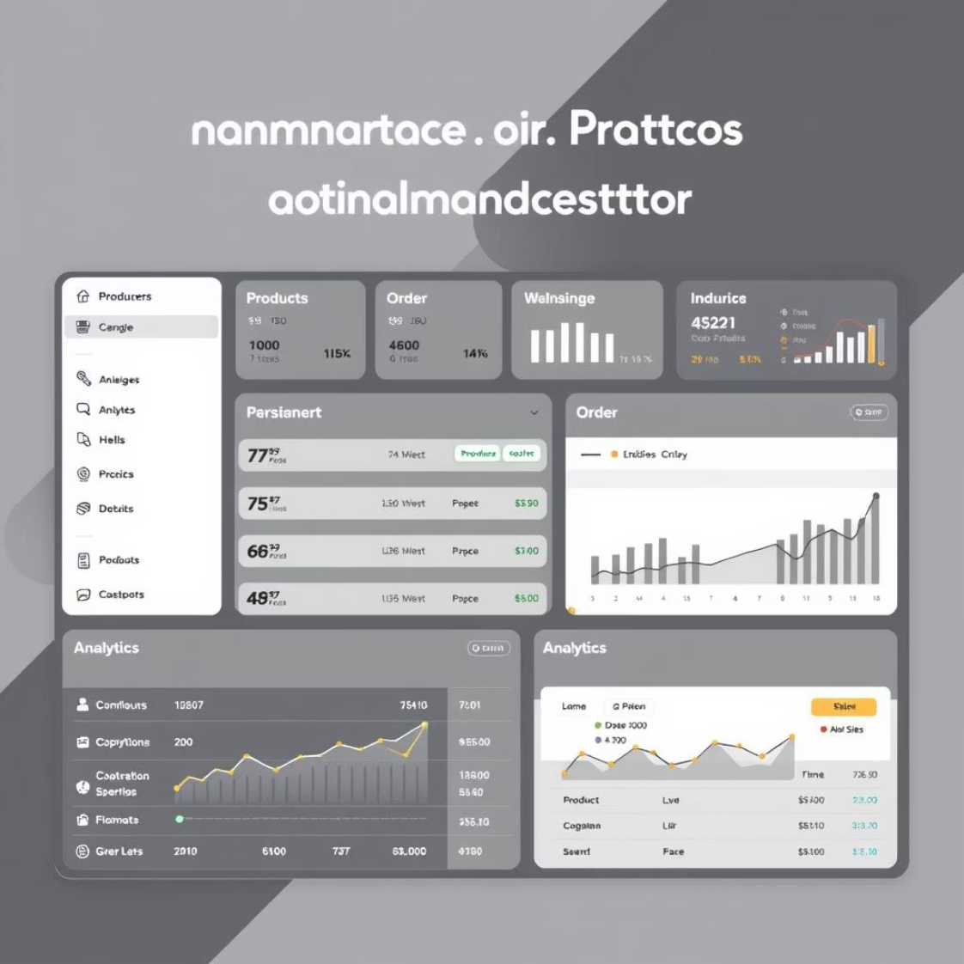

Who Benefits? Our Key End Users
The Online Shopper
The E-commerce Administrator
The Development Team
Our backend ensures a smooth and secure shopping journey. Users can easily browse products, add items to their cart, proceed through a seamless checkout process, and manage their orders and profiles with confidence. The rapid response times and robust security measures contribute to a trustworthy and enjoyable experience, encouraging repeat business.
For administrators, the backend provides powerful tools for efficient platform management. This includes comprehensive dashboards for product inventory, order tracking, user management, and performance monitoring. The intuitive API design simplifies integration with various administrative interfaces, streamlining operations and reducing manual workload.
Developers will find our API to be well-documented, consistent, and easy to integrate with various frontend frameworks and third-party services. The modular architecture facilitates collaborative development, reduces onboarding time for new team members, and allows for rapid feature deployment, accelerating the development lifecycle.
By focusing on these distinct user groups, we've designed a backend that not only meets their specific needs but also enhances their overall interaction with the e-commerce platform.

Slide 6
Tangible Results: A Fully Functional & Optimized API
99.9%
<100ms
100%
API UptimeGuaranteed high availability ensures continuous service.
Average Response TimeFast processing for user interactions.
Security ComplianceAdherence to industry best practices.
We successfully delivered a robust, high-performance API that is the backbone of a modern e-commerce platform.
User Authentication: Secure registration, login, and profile management with JWTs and bcrypt, ensuring user data privacy and session integrity.
Product Management: Comprehensive CRUD operations for products, including detailed descriptions, images, pricing, and inventory tracking. Categorization and search functionalities are also fully implemented.
Order Processing: End-to-end order lifecycle management, from shopping cart to order confirmation, payment integration (simulated), and status updates. Efficient handling of order details, shipping information, and historical data.
Scalability: The API is designed to handle increasing loads and data volumes, ensuring the platform can grow without significant architectural changes.
Maintainability: Clean, modular code structure facilitates future enhancements and bug fixes, reducing long-term development costs.

Slide 7
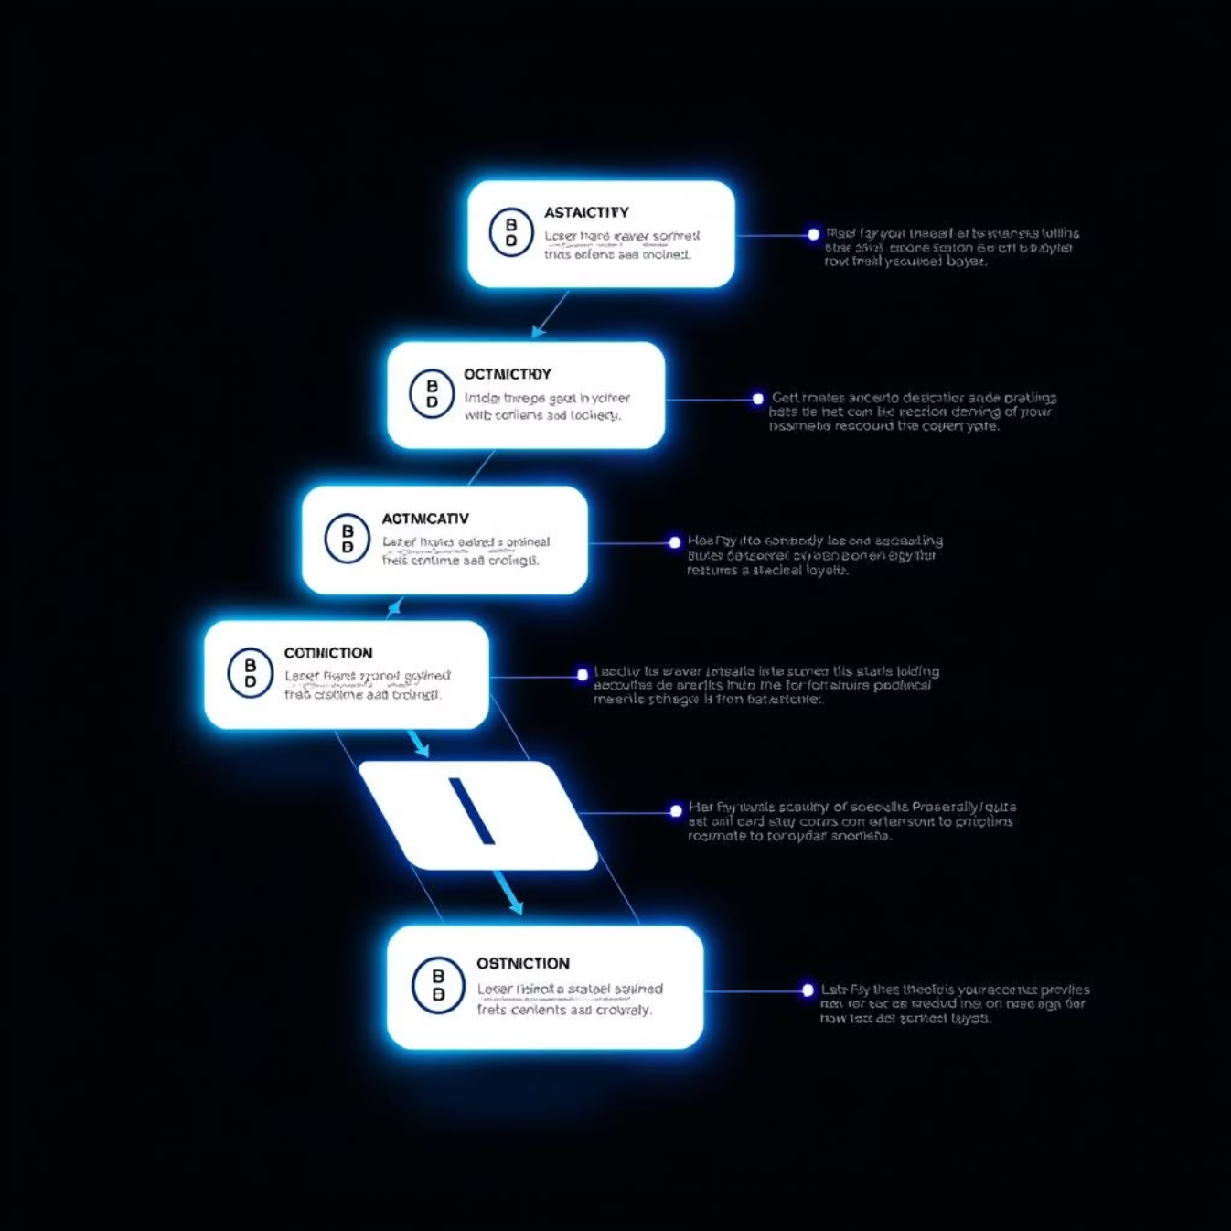
Conclusion & Next Steps
Key Takeaways
Our e-commerce backend system provides a robust, scalable, and secure foundation for any online retail venture. By focusing on modern technologies like Node.js and PostgreSQL, we've built an API that ensures high performance, data integrity, and an excellent user experience. The modular design allows for easy expansion and adaptation to future business needs, making it a sustainable solution for long-term growth. This project not only demonstrates our technical proficiency but also our commitment to delivering high-quality, production-ready systems.
Future Scope & Enhancements
The current system serves as a strong foundation, but there are several avenues for future enhancement:
Payment Gateway Integration: Implement real-world payment gateways (e.g., Stripe, PayPal) for live transactions.
Advanced Search & Filtering: Introduce more sophisticated search capabilities and dynamic filtering options for products.
Recommendation Engine: Develop a personalized product recommendation system based on user behavior and purchase history.
Inventory Management System: Build out a comprehensive system for real-time stock updates, low-stock alerts, and supplier integration.
User Reviews & Ratings: Add functionality for customers to leave reviews and ratings on products.
Admin Dashboard: Create a dedicated admin interface for managing products, orders, users, and analytics.

Slide 8






Connect & Explore Our Work
GitHub Repository
Explore the full codebase, contribute, or fork the project. Our GitHub repository contains all the necessary files, including setup instructions and detailed documentation.
Live Demo
Experience the API in action with a live demonstration of our backend system integrated with a sample frontend.
We invite you to explore our work further and engage with us. Your feedback and insights are invaluable as we continue to refine and expand this project. Thank you.

